Slide 1
Process Synchronization
The Critical-Section Problem
Peterson’s Solution
Synchronization Hardware
Mutex Locks
Semaphores
Classic Problems of Synchronization
Monitors

Slide 2
Producer
while (true)
{
/* produce an item and put in nextProduced */
while (counter== BUFFER_SIZE)
; // do nothing
buffer [in] = nextProduced;
in = (in + 1) % BUFFER_SIZE;
counter++;
}

Slide 3
Consumer
while (true)
{
while (counter == 0)
; // do nothing
nextConsumed = buffer[out];
out = (out + 1) % BUFFER_SIZE;
counter--;
/* consume the item in nextConsumed
}

Slide 4
Race Condition
counter++ could be implemented as register1 = counter register1 = register1 + 1 counter = register1
counter-- could be implemented as register2 = counter register2 = register2 - 1 counter = register2

Slide 5
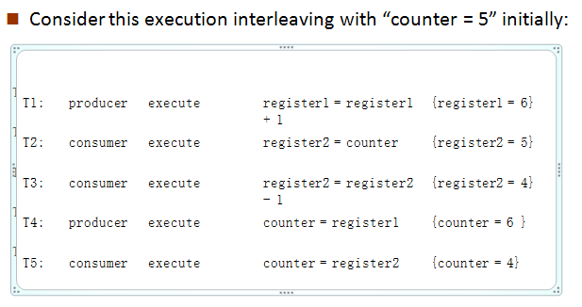
Race Condition

Slide 6
Critical section problem
Critical section – segment of code
changing common variables
Updating a table
Writing a file etc.
Entry section
Exit section
Remainder section

Slide 7
Critical section problem
do
{
critical section
remainder section
}while (TRUE);
Figure: General structure of a typical process P_{i}
Entry section
Exit section

Slide 8
Solution to Critical-Section Problem
1. Mutual Exclusion - If process P_{i} is executing in its critical section, then no other processes can be executing in their critical sections
Progress - If no process -critical section
some process - enter their critical section,
selection cannot be postponed indefinitely
3.Bounded Waiting - A bound must exist on the number of times that other processes are allowed to enter their critical sections

Slide 9
Ex:
Kernel – maintaining list of open files
Approaches to handle critical section in OS:
Preemptive kernels: allows a process to be preempted while it is running in kernel mode
Ex: Linux 2.6 kernel
Nonpreemptive kernels: does not allow a process running in kernel mode to be preempted
Ex: Windows XP, Windows 2000

Slide 10
Peterson’s Solution
s/w based solution to critical-section problem
Two process solution – P_{i} & P_{j}
The two processes share two variables:
int turn; → indicates whose turn it is to enter the critical section.
boolean flag[2] → indicates if a process is ready to enter the critical section
flag[i] = true ➔ process P_{i} is ready!

Slide 11
Algorithm for Process P_{i}
do {
flag[i] = TRUE;
turn = j;
while (flag[j] && turn == j);
critical section
flag[i] = FALSE;
remainder section
} while (TRUE);
Figure: Structure of process in P_{i} Peterson’s solution

Slide 12
1. How mutual exclusion is preserved?
P_{i} to enter into critical section: flag[j]=0
turn=i
2. If both P_{i} and P_{j} execute critical section at same time:
flag[0] = flag[1] = 1
turn = i or j → only one is possible

Slide 13
2. How progress requirement and bounded waiting requirements are satisfied?
P_{i} can be prevented from entering critical section if :
flag[j] = 1 & turn = j
If P_{j} is not ready to enter the critical section, then
flag[j] = 0
P_{i} can enter into critical section
If P_{j} has set flag[j] = 1 & executing remainder section, then turn = i or turn = j.
If turn = i ➔ P_{i} will enter critical section
If turn = j ➔ Pj will enter critical section

Slide 14
Synchronization Hardware
Solution to critical section problem requires a tool → lock
Critical regions protected by locks -> prevents race conditions
do
{
critical section
remainder section
} while (TRUE);
Uniprocessors : prevent interrupts from occurring while modifying shared variable.
Won’t work in multiprocessor environment because disabling interrupts is time consuming
acquire lock
release lock

Slide 15
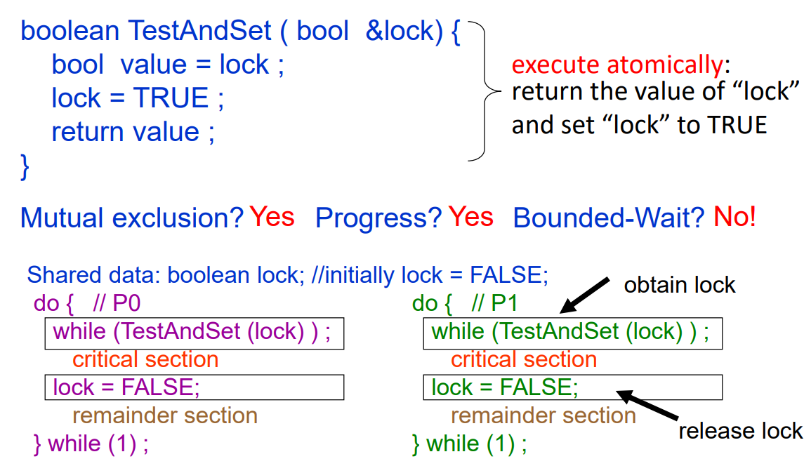
TestAndSet Instruction

Slide 16
Swap Instruction
Definition:
void Swap (boolean *a, boolean *b)
{
boolean temp = *a;
*a = *b;
*b = temp:
}

Slide 17
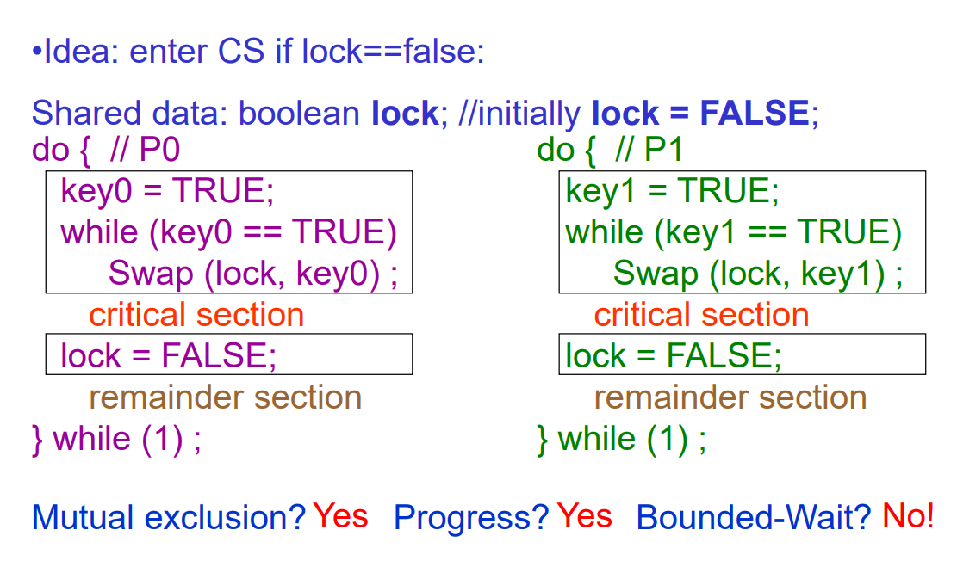
Solution using Swap
Shared Boolean variable lock initialized to FALSE; Each process has a local Boolean variable key

Slide 18
Bounded-waiting Mutual Exclusion with TestandTet()
do {
waiting[i] = TRUE;
key = TRUE;
while (waiting[i] && key)
key = TestAndSet(&lock);
waiting[i] = FALSE;
// critical section
j = (i + 1) % n;
while ((j != i) && !waiting[j])
j = (j + 1) % n;
if (j == i)
lock = FALSE;
else
waiting[j] = FALSE;
// remainder section
} while (TRUE);

Slide 19
Semaphore
Synchronization tool that does not require busy waiting
Semaphore S → integer variable
Two standard operations modify S: wait() and signal()
Originally called P() and V()
Less complicated
Can only be accessed via two indivisible (atomic) operations
wait (S)
{
while S <= 0
; // no-op
S--;
}
signal (S)
{
S++;
}

Slide 20
Semaphore as General Synchronization Tool
Counting semaphore – integer value can range over an unrestricted domain
Binary semaphore – integer value can range only between 0 and 1; can be simpler to implement
Also known as mutex locks
Can implement a counting semaphore T as a binary semaphore
Provides mutual exclusion
semaphore mutex; // initialized to 1
do {
wait (mutex);
// Critical section
signal (mutex);
// remainder section
} while (TRUE);

Slide 21
Semaphore Implementation
Must guarantee that no two processes can execute wait () and signal () on the same semaphore at the same time
Thus, implementation becomes the critical section problem where the wait and signal code are placed in the critical section.
Could now have busy waiting in critical section implementation
But implementation code is short
Little busy waiting if critical section rarely occupied
Note that applications may spend lots of time in critical sections and therefore this is not a good solution.

Slide 22
Semaphore Implementation with no Busy waiting
With each semaphore there is an associated waiting queue. Each entry in a waiting queue has two data items:
value (of type integer)
pointer to next record in the list
Two operations:
block – place the process invoking the operation on the appropriate waiting queue.
wakeup – remove one of processes in the waiting queue and place it in the ready queue.
typedef struct {
int value;
struct process *list;
}semaphore;

Slide 23
Semaphore Implementation with no Busy waiting (Cont.)
Implementation of wait:
wait(semaphore *S) {
S->value--;
if (S->value < 0) {
add this process to S->list;
block();
}
}
Implementation of signal:
signal(semaphore *S) {
S->value++;
if (S->value <= 0) {
remove a process P from S->list;
wakeup(P);
}
}

